Slide 1
Chapter 3
Three Claims, Four Validities

Slide 2
Agenda
Variables
Three Claims
Four Types of Validity
Interrogating the Three Claims Using the Four Big Validities
Research Activity 3
Next time on PSY 270…

Slide 3
Variables
Types of variables
Defining variables

Slide 4
Variables
Variable – something that changes or varies, so it can have 2+ values or levels
  Level – Different options within a variable
Constant – something within the experiment that stays the same
Practice 1: Asking college students whether their preferred pet is a cat, dog, or fish
Practice 2: Timing how long athletes take to run 100 meters

Slide 5
Variables
Measured variable – the variable observed and recorded
  Also called the dependent variable
Manipulated variable – the variable the experimenter controls
  Also called the independent variable
Practice: Evaluating whether students’ grades are better when they work on assignments independently or in groups

Slide 6
Defining Variables
Construct – the concept/ topic
  Ex: depression
Conceptual definition – the theoretical definition of the construct
  Ex: a feeling of sadness, lethargy, or emptiness
Operational definition – how the construct is measured/ manipulated in a particular study
  Ex: A study uses the Depression Anxiety Stress Scale, and defines levels of depression as:
  Normal: score of 0-9
  Mild depression: score of 10-13
  Moderate depression: score of 14-20
  Severe depression: score of 21-27
  Extremely severe depression: score of 28+

Slide 7
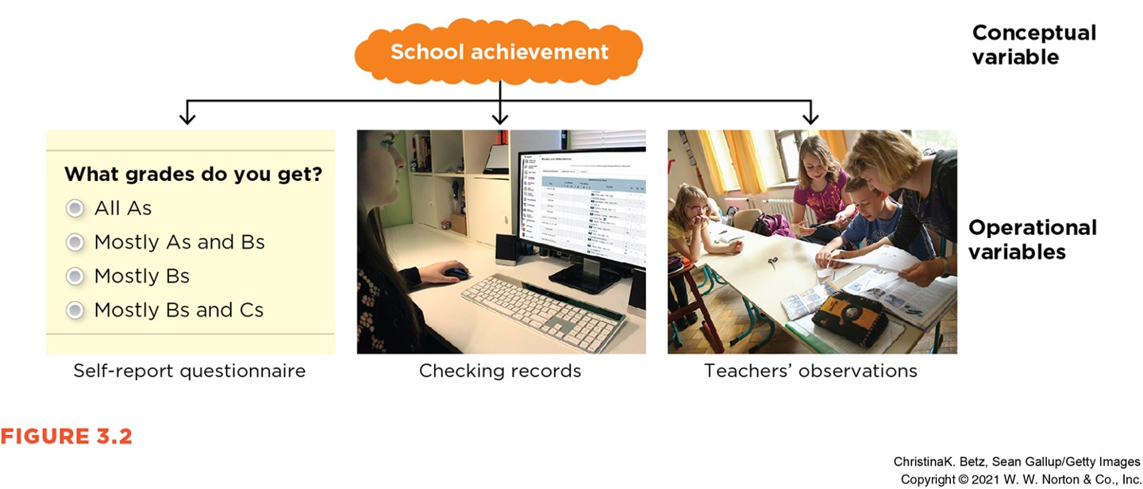
Defining Variables

Slide 8
Three Claims
Frequency claims
Association claims
Causal claims

Slide 9
Frequency Claims
A frequency claim describes a particular level or degree of a single variable.
Frequency claims involve only one measured variable.
For example…
  21% of Canadian adolescents ages 15–17 reported vaping in the last month
  The global average life expectancy is 73 years
  9 out of 10 dentists say Sensodyne is the best toothpaste
  50 out of 50 students say Dr. S is the coolest professor EVER

Slide 10
Association Claim
An association claim argues that one level of a variable is likely to be associated with a particular level of another variable.
Association claims are supported by studies that have at least two measured variables.
Variables that are associated are said to covary (when changes in one variable are related to changes in a second variable)
  Covariance – tells you the direction of the relationship
  Correlation – tells you the direction and strength of the relationship
  Can be positive, negative, or zero

Slide 11
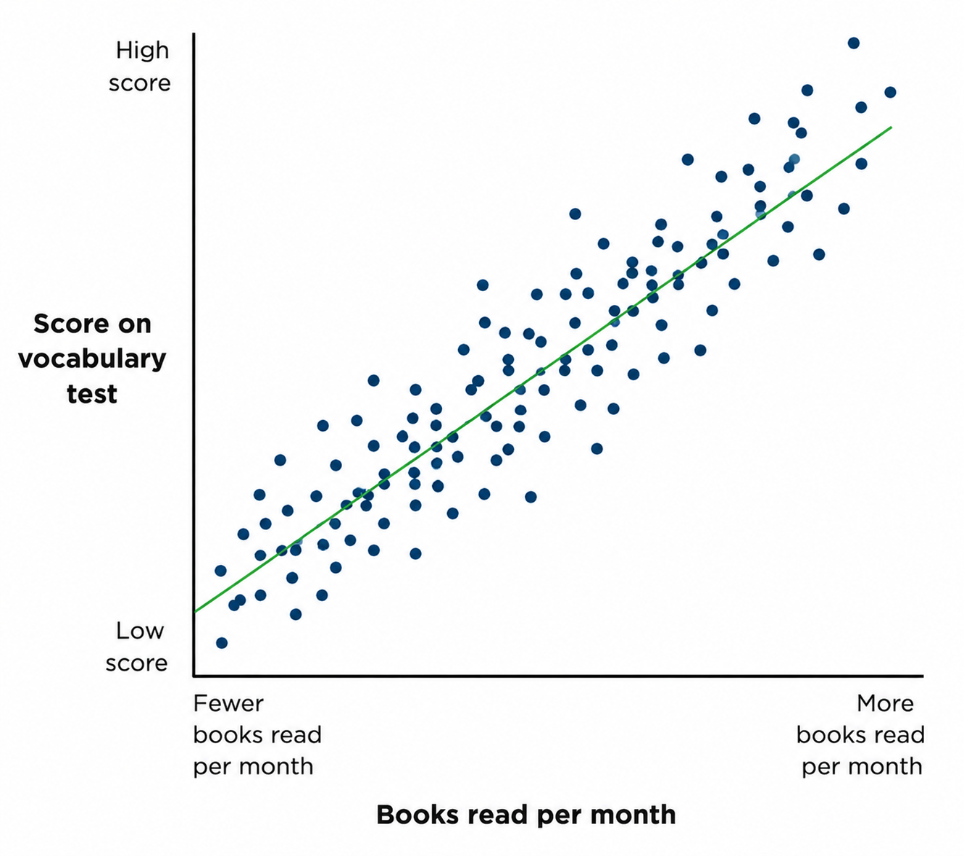
Books Read and Vocabulary Scores
What type of association?

Slide 12
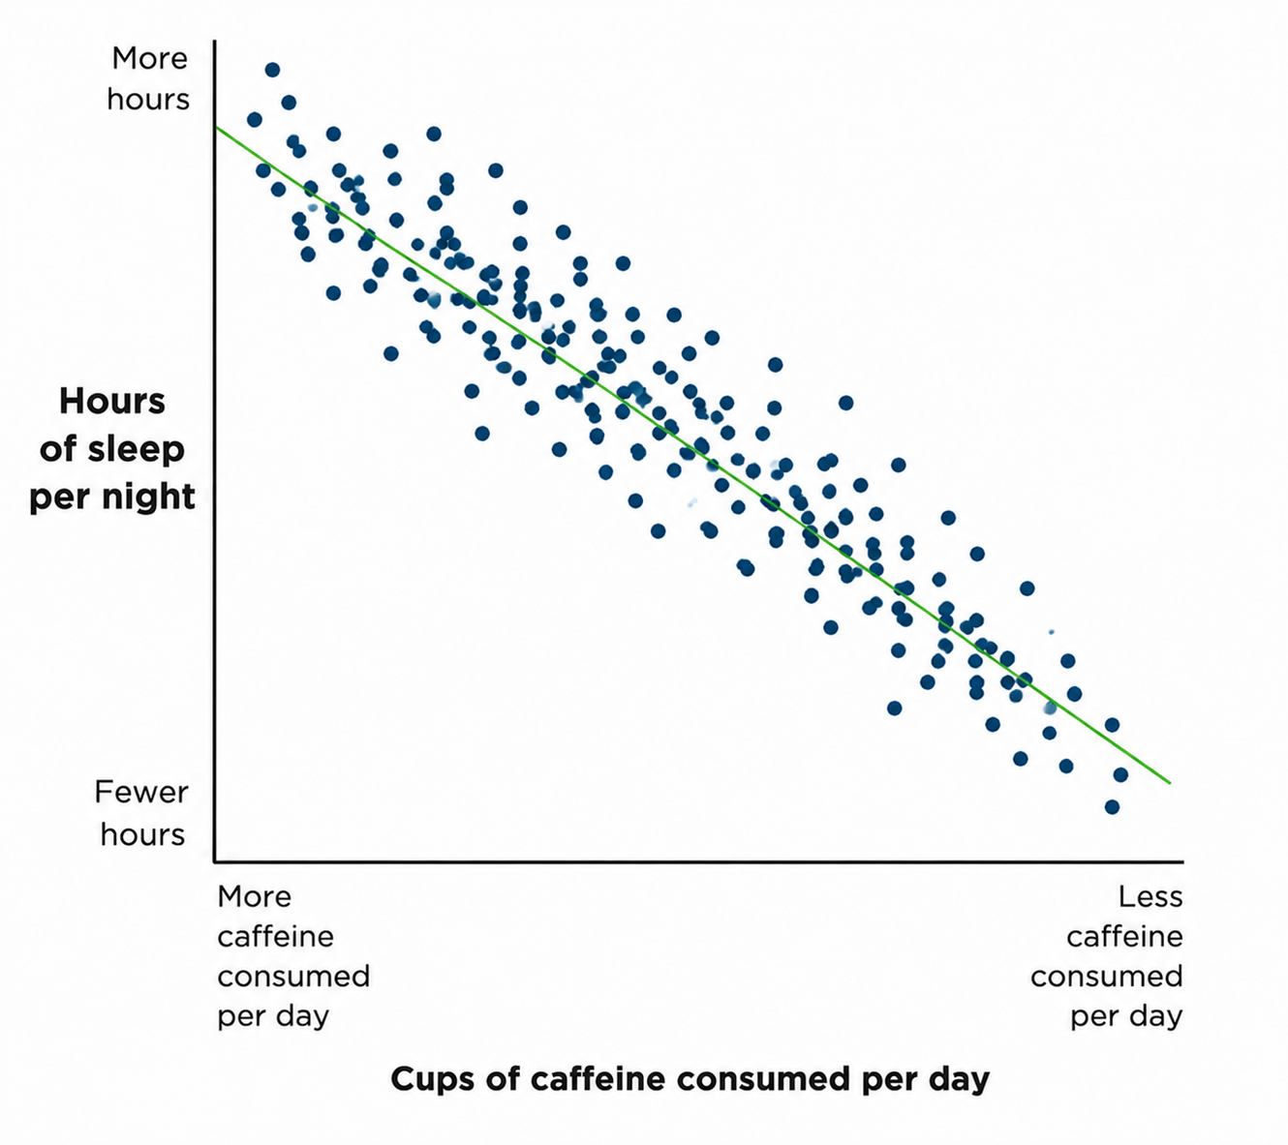
Caffeine Consumption & Hours of Sleep
What type of association?

Slide 13
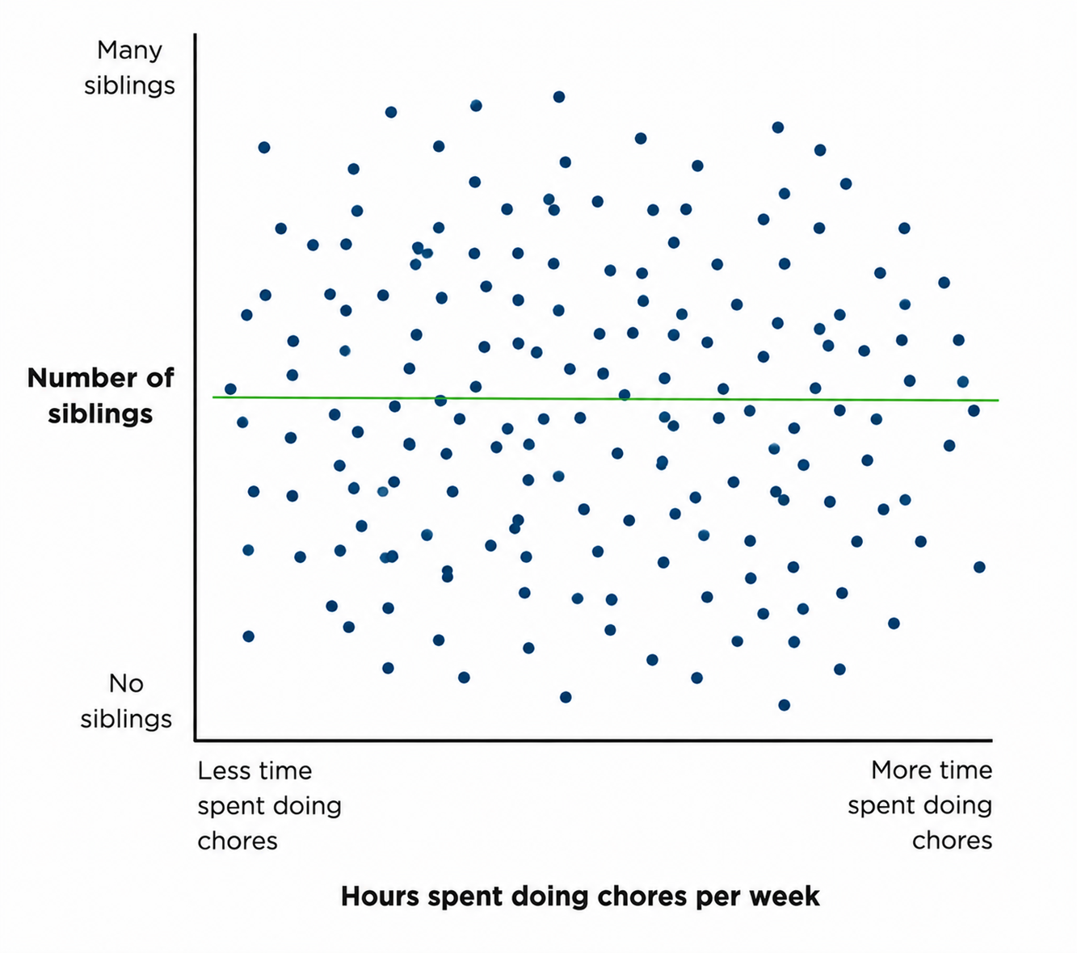
Siblings and Chores
What type of association?

Slide 14
Making Predictions Based on Associations
Some association claims are useful because they help us make predictions.
  Note: This is still just a guess
The stronger the association between the two variables, the more accurate the prediction will be.
Both positive and negative associations can help us make predictions, but zero associations cannot.

Slide 15
Causal Claims
A causal claim argues that one variable causes changes in the level of another variable.
Causal claims are supported by experiments (studies that have a manipulated variable and a measured variable.)
Criteria for a causal claim:
  Covariance - the two variables MUST be related
  Temporal precedence – the causal variable must come BEFORE the outcome variable
  Internal validity – the study must rule out all other possible outcomes

Slide 16
Causal Claim Examples
Baby’s superpowered scent can affect parents’ moods, researchers find
Talking to strangers might make you happier
Logic’s song 1-800-273-8255 may have led to hundreds of fewer suicides
Pretending to be Batman helps kids stay on task
To appear more intimidating, just tilt your head down, study suggests
Family meals curb teen eating disorders

Slide 17
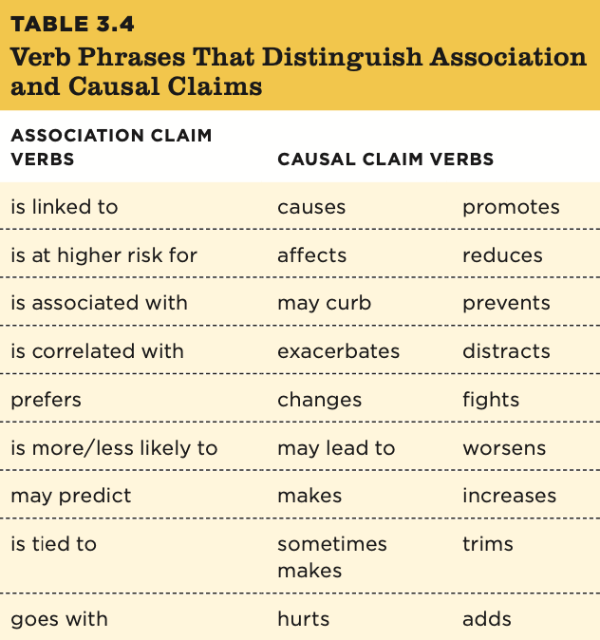
Watch Your Language!

Slide 18
Not All Claims Are Based on Research
Not all claims we read about in the popular press are based on research.
Some claims are based on experience, intuition, or authority.
Examples:
  Paranoia, voices, sleeplessness: What my psychotic break felt like for some teens, as masks come off, anxiety sets in
  Octopuses caught on camera throwing junk at each other during underwater fights
  For some with ADHD, the low rumble of brown noise quiets the brain
We see these A LOT in journalism

Slide 19
Four Types of Validity
Construct Validity
Statistical Validity
Internal Validity
External Validity

Slide 20
Construct Validity
Validity – the appropriateness of a conclusion or decision
Construct validity – how well the variables in a study are measured or manipulated
  Do operational variables = conceptual variables
Ex: Does the Depression Anxiety Stress Scale actually represent stress?

Slide 21
Statistical Validity
Statistical validity – how well the numbers support the claim
Is the value correct? Is it precise?
  Point estimate – the single value representing a person or group (ex: response time or class average)
What we look for:
  Strength of effect
  Statistical significance
  Preciseness of estimate (confidence intervals, margins of error, etc.)
  Replication

Slide 22
Internal Validity
Internal validity – the extent to which the researcher is confident that one variable caused the second variable
  Note: this means you need at least two variables
You must make sure that no other variable could have impacted the outcome
Ex: Did month of the year cause ice cream consumption, or was another variable the cause of the ice cream consumption?

Slide 23
External Validity
External validity – the extent to which the results can generalize to a different or larger population
Ex: can the months -> ice cream consumption generalize to Australia?

Slide 24
Interrogating the Three Claims Using the Four Big Validities
Interrogating frequency claims
Interrogating association claims
Interrogating causal claims
Prioritizing validities

Slide 25
Interrogating Frequency Claims
Construct validity
Statistical validity
External validity

Slide 26
Interrogating Association Claims
Construct validity
Statistical validity
External validity

Slide 27
Interrogating Causal Claims
Internal validity
Statistical validity
External validity
Construct validity

Slide 28
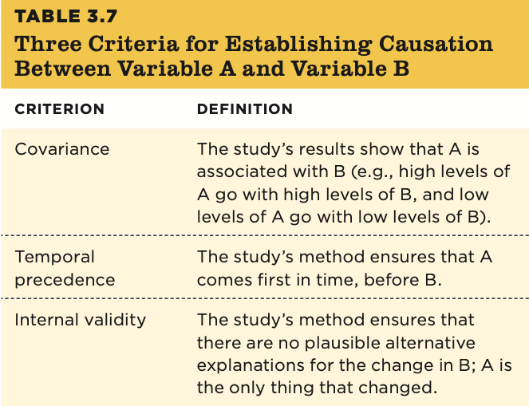
Causal Criteria

Slide 29
Experiments Support Causal Claims
In order to support a causal claim, a researcher needs to conduct an experiment in which one variable is manipulated and the other is measured.
Example experiment: does music improve cognitive ability?
Independent variable – manipulated or variable (cause) in an experiment
  Ex: type of lessons; four levels: keyboard, voice, drama, no lessons
Dependent variable – measured variable (effect) in an experiment
  Ex: IQ
Random assignment – a method of assigning participants to levels of the independent variable such that each group is as similar as possible
  Example methods: random number generator, flipping a coin, rolling a die
  increases internal validity by controlling for potential alternative explanations

Slide 30
Warning!
Not all studies support causal claims!
(This is an area journalism can go awry)

Slide 31
Scenario
Study Measures:
  Number of meals had as a family
  If the teen girl had an eating disorder or not
Results:
  Of the teen girls who ate with their families more often (>5 times/ week), 17% had eating disorders
  Of the teen girls who ate with their families less often (<5 times/ week), 26% had eating disorders

Slide 32
Causal Claim Mistakes
Ex: Do family meals really curb eating disorders in teen girls?
Covariance criteria met?
Temporal precedence met?
Internal validity?
Yes, there is an association between family meals and eating disorders.
Did the family meals increase before the eating disorders decreased? It’s not clear.
No. We can’t rule out third-variable explanations without an experiment.

Slide 33
Interrogating Causal Claims
We have been emphasizing internal validity because it is only important when interrogating causal claims. However, we still need to consider the three other types of validity:
  Construct validity
  External validity
  Statistical validity

Slide 34
Prioritizing Validities
Which of the four validities is most important?
It depends on the study and the claims made
  Example: Internal validity is typically a top priority when making causal claims but not when making frequency or association claims.

